Slide 1
Automobile World
DAB-103 Analytical Tools & Decision Making

Slide 2
Group 002
Group Members
1.Vishant Bhatia
2.Asbin Ghimire
3.Mahima Mehandiratta
4.Alisha Mahajan
5.Harshita Sanjay Dhiman

Slide 3
Contents
Proposal
Motivation
Data Description
Problem Statement
Target Audience
Analyzing Questions
Exploratory Data Analysis

Slide 4
Data Description
Dataset Link :https://data.world/vizwiz/car-sales-mock-data
Rows: 10,000, Columns: 20
Data Types
Boolean
Float
Integer
object
Automobile World
Categorical
Make
model
Car gender
Buyer gender
Country
City
Buzzword
colour
New car
Numeric Variables
Buyer age
Dealer Latitude
Dealer longitude
Top speed
0-60 time
Discount
Sale price
Resale price

Slide 5
Motivation
The automobile industry, over the years, has revolutionized modern society making people more approachable to jobs and services, and above all personal freedom. Earlier, people relied on public transit to commute but with the comfort and ease that comes with a car, we have seen a huge shift from public transport to personal cars. However, not everyone can afford the luxury of a new car owing to numerous reasons thus increasing the market of used cars. The basis for selecting this dataset is to make data-driven decisions about sales of used cars in different countries based on different aspects such as the colour, make, model, depreciation, buyer gender and age, to name a few.

Slide 6
Problem Statements
Analyzing the dataset will help us gain insights into the used car sales market. What are the factors that an individual considers while looking for a used car? Which gender across the globe is more inclined towards buying a used car rather than a new one? Which country around the world has a booming second-hand car market?

Slide 7
Target Audience
Car Resellers
Car Buyers
Car Companies

Slide 8
Analyzing Questions
Explain the sales and profits of second-hand cars market across the globe?
How to recommend a car the with its model or by special features?
Which maker has more resell value?
Is the car worth the money? (comparison between car’s sale price and resell price)
What is the correlation between sale price and resell price?
What age group is more interested in purchasing cars?
How to depict country-by-country sales of automobile manufacturers?

Slide 9
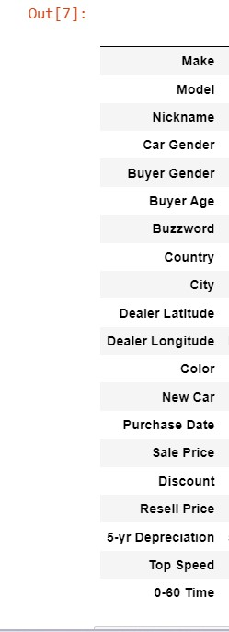
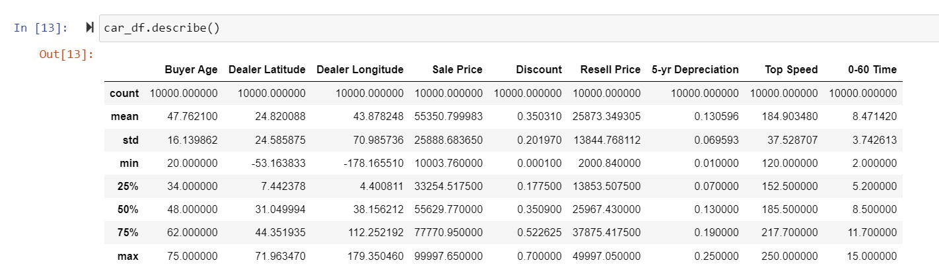
Exploratory Data Analysis
Calculation of certain statistical information about the DataFrame's numerical values, such as percentile, mean, and standard deviation.

Slide 10
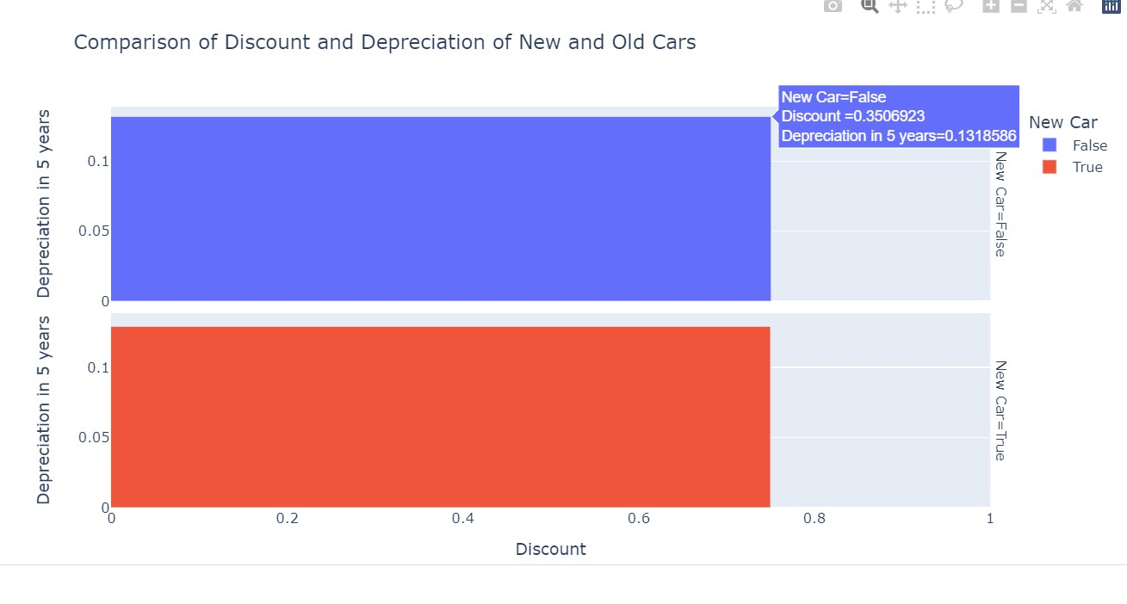
Exploratory Data Analysis
Analysis of discount and depreciation of different cars.

Slide 11
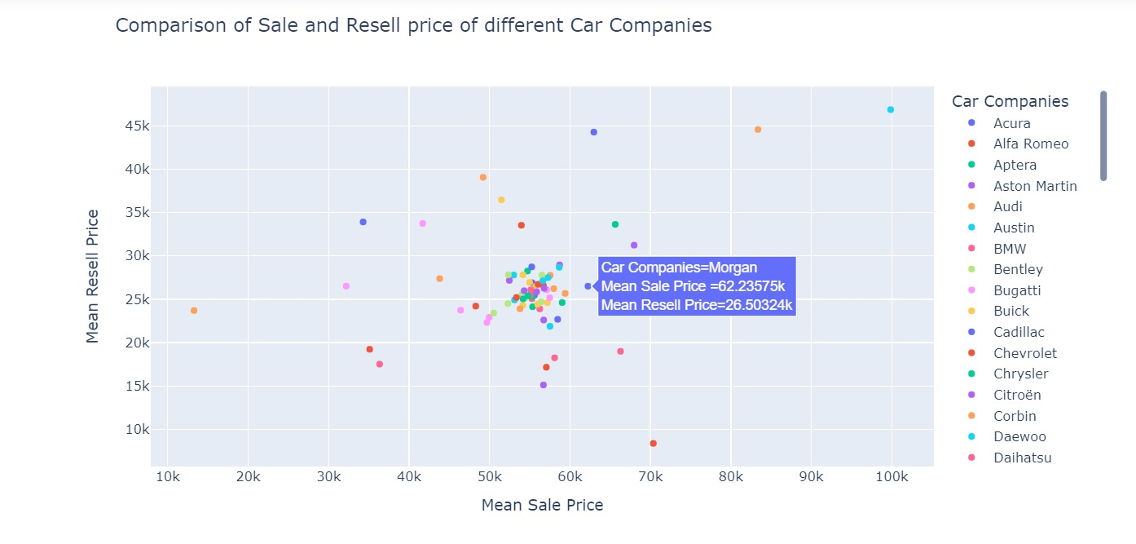
Exploratory Data Analysis
Analysis of sale and resell price of different car companies .

Slide 12
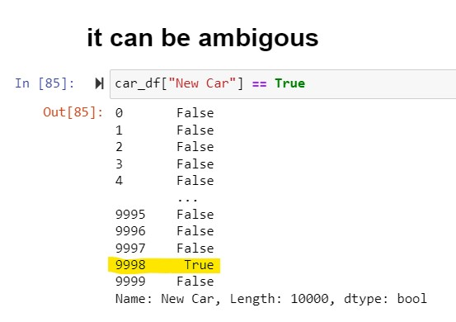
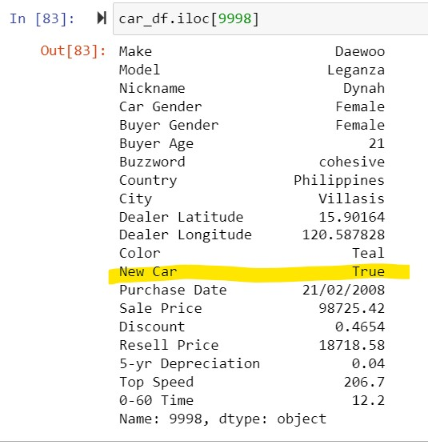
Exploratory Data Analysis
We are analysing the ambiguity of our dataset

Slide 13
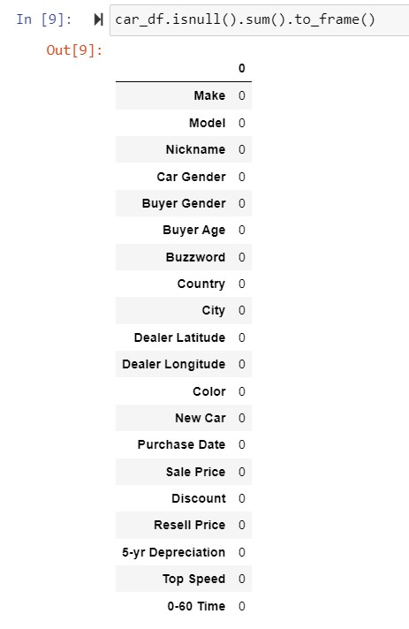
Exploratory Data Analysis
Table for the count of null values in our
datasets.

Slide 14
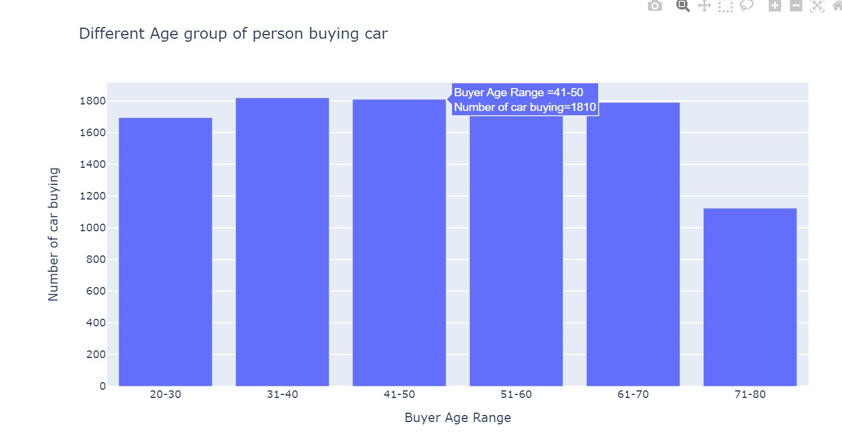
Exploratory Data Analysis
Analysis of different age group buying the data.

Slide 15
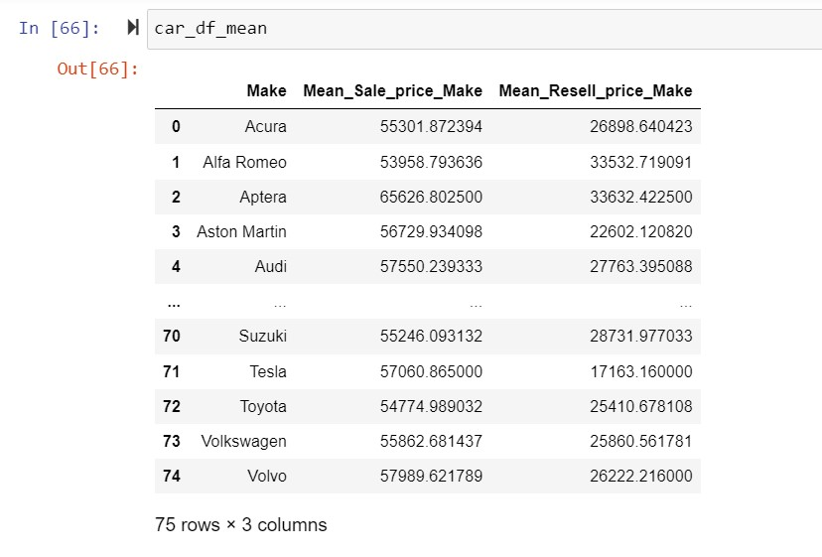
Exploratory Data Analysis
This table depicts the mean of resell and sale price of different car companies .

Slide 16
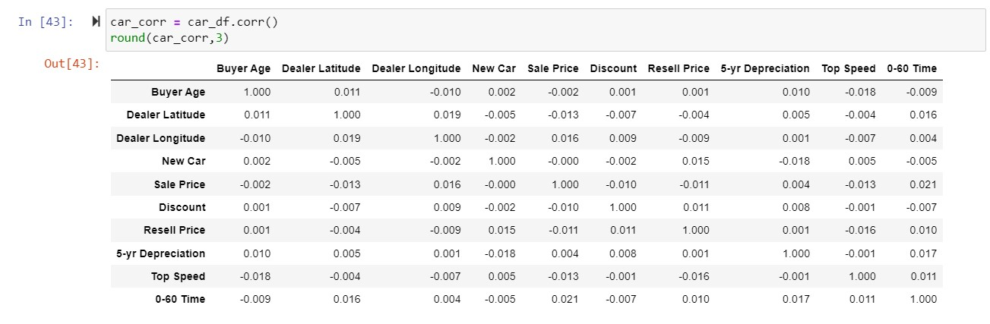
Exploratory Data Analysis
Corelation between different features of our datasets .

Slide 17
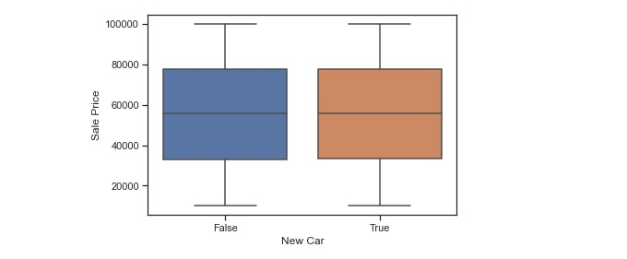
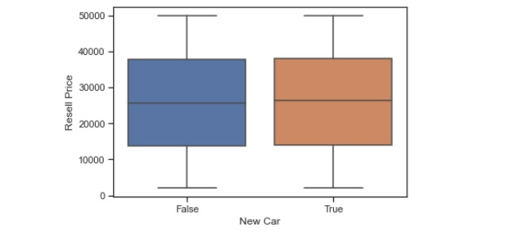
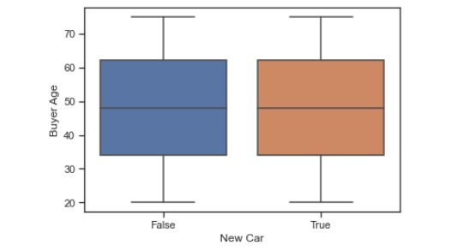
Exploratory Data Analysis

Slide 18
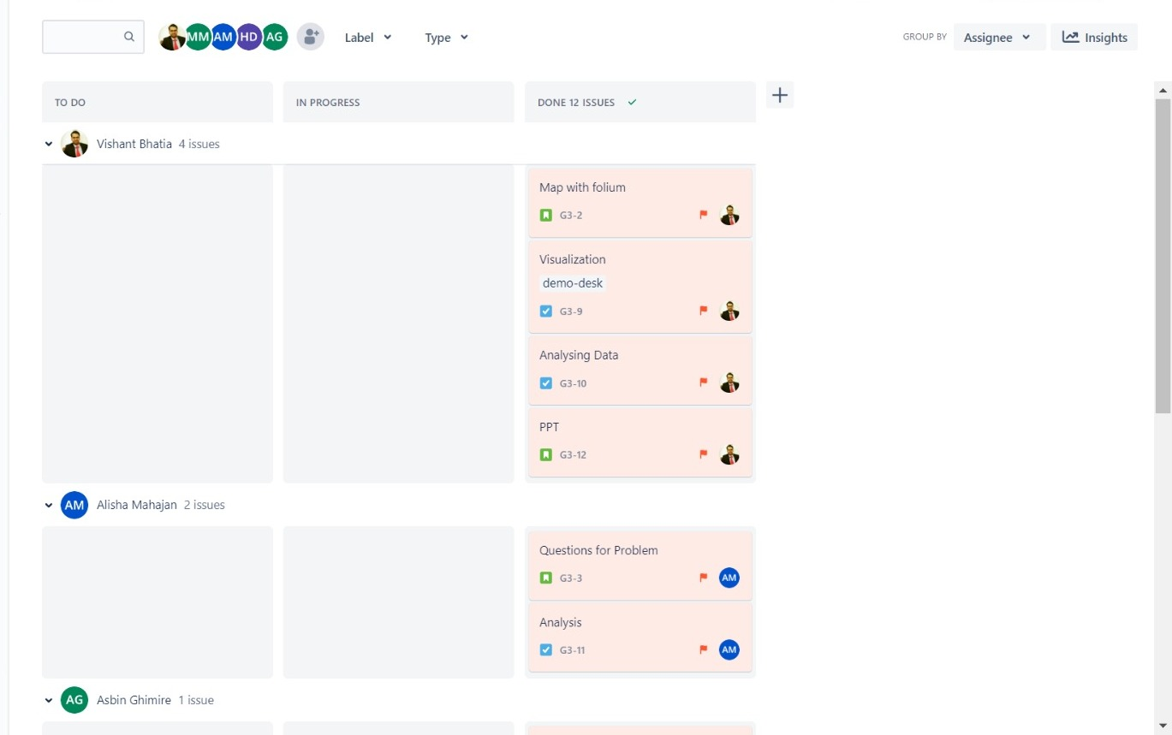
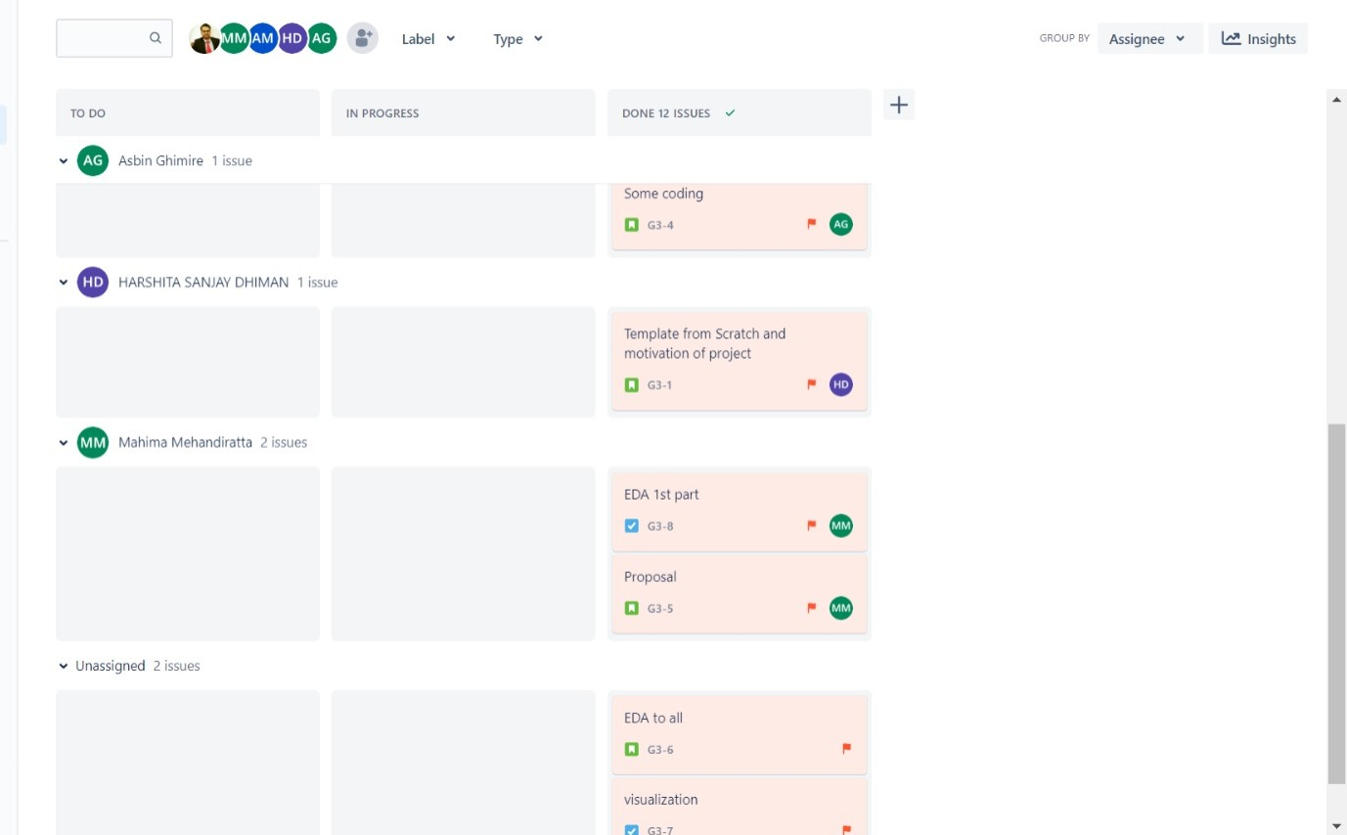
Jira work distribution

Slide 19
GitHub repository link:-
https://github.com/harshita0410/automobile_project

Slide 20
Thank You !

